Slide 1
Dream Up
Owen McCormack
Jacob Phillips

Slide 2

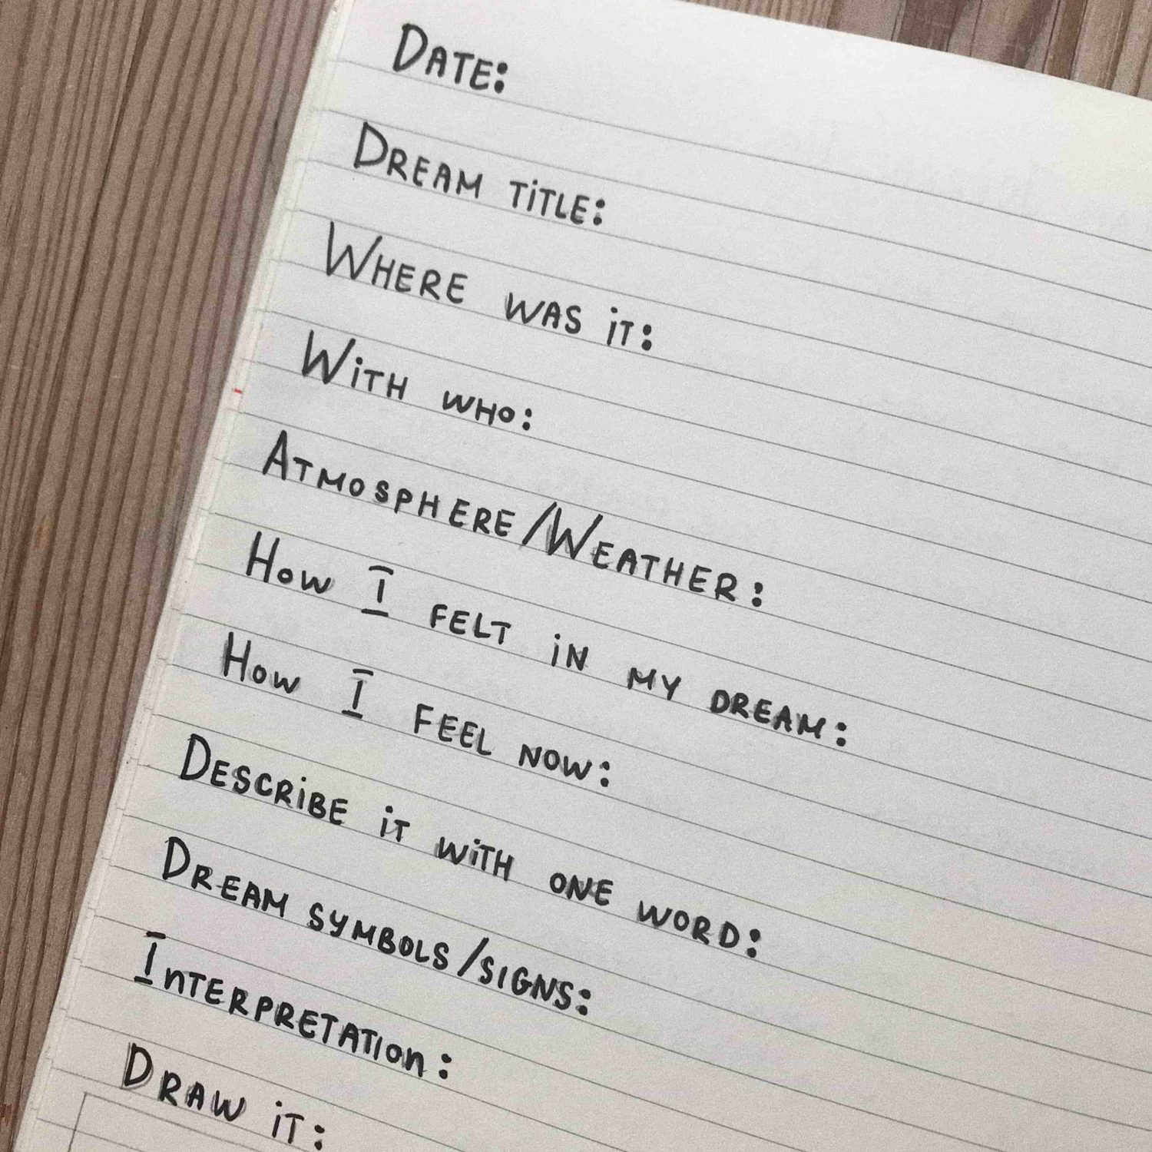
App Overview
Allow the user to log info about their dreams.
Info includes a reaction, drawing, fragments, tags, and a description.
Store dream info in a local DB.
Allow the user to set repeating notifications to enter new dreams.

Slide 3
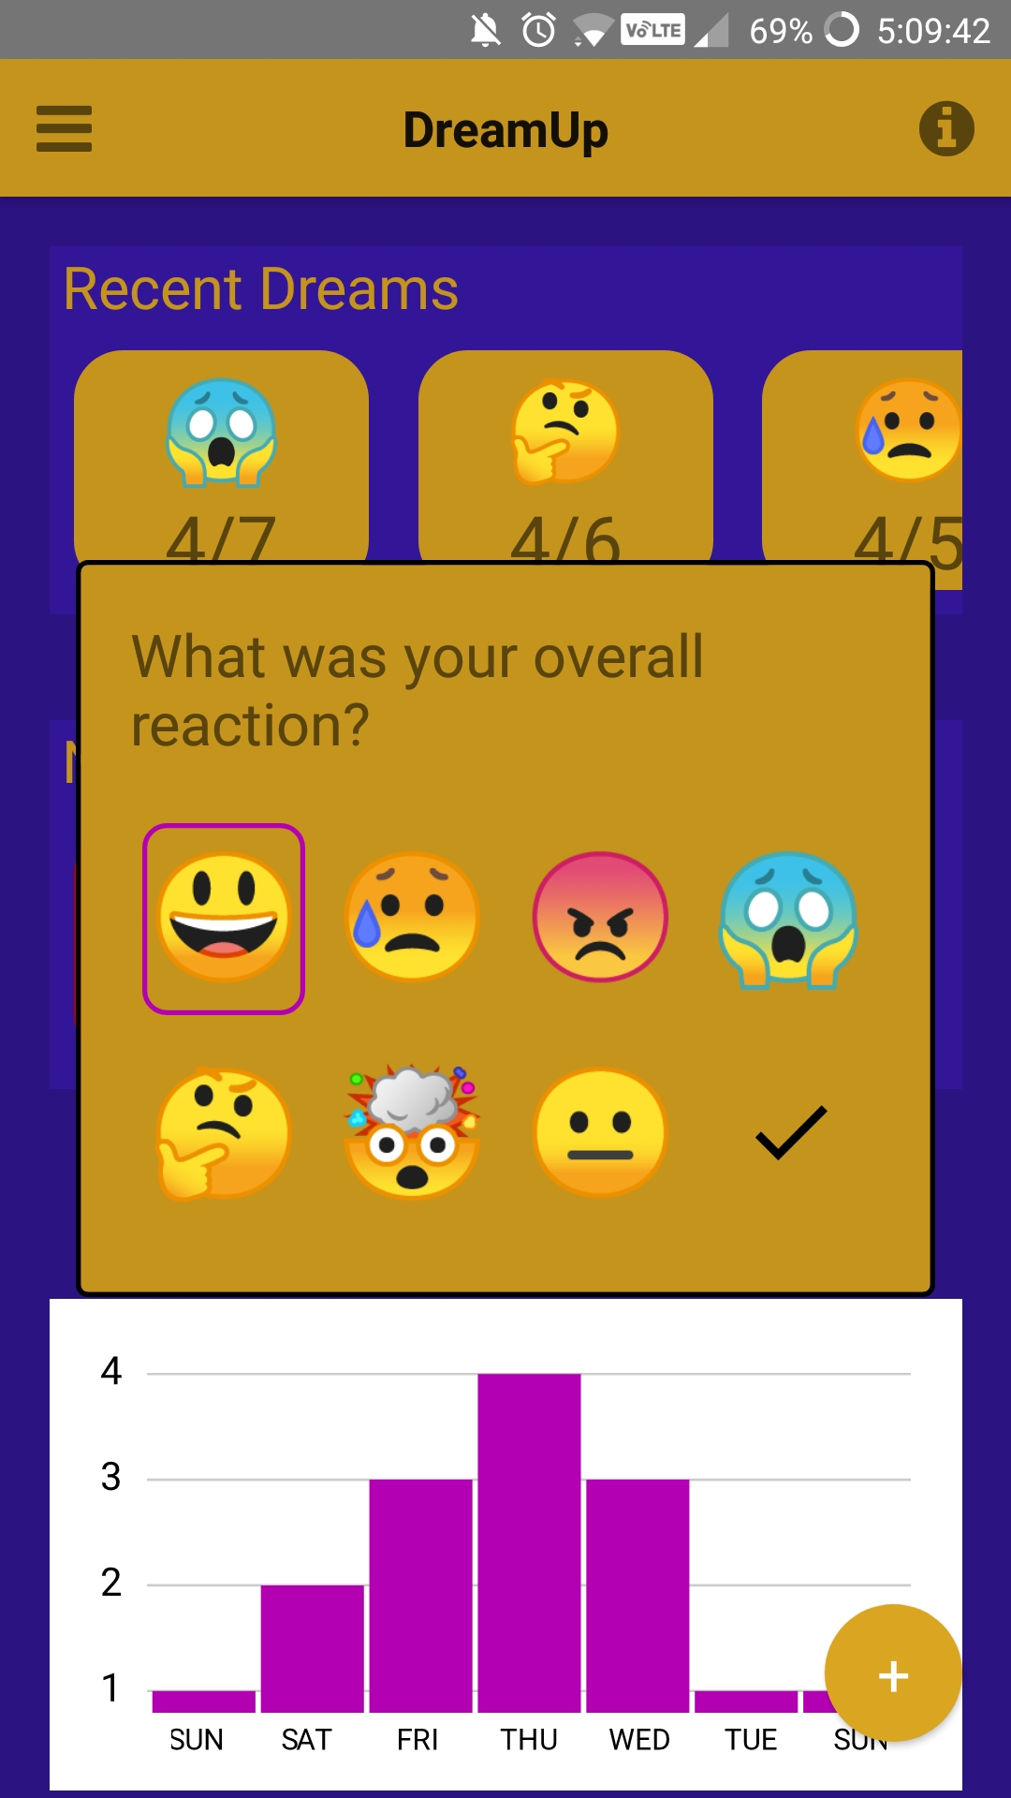
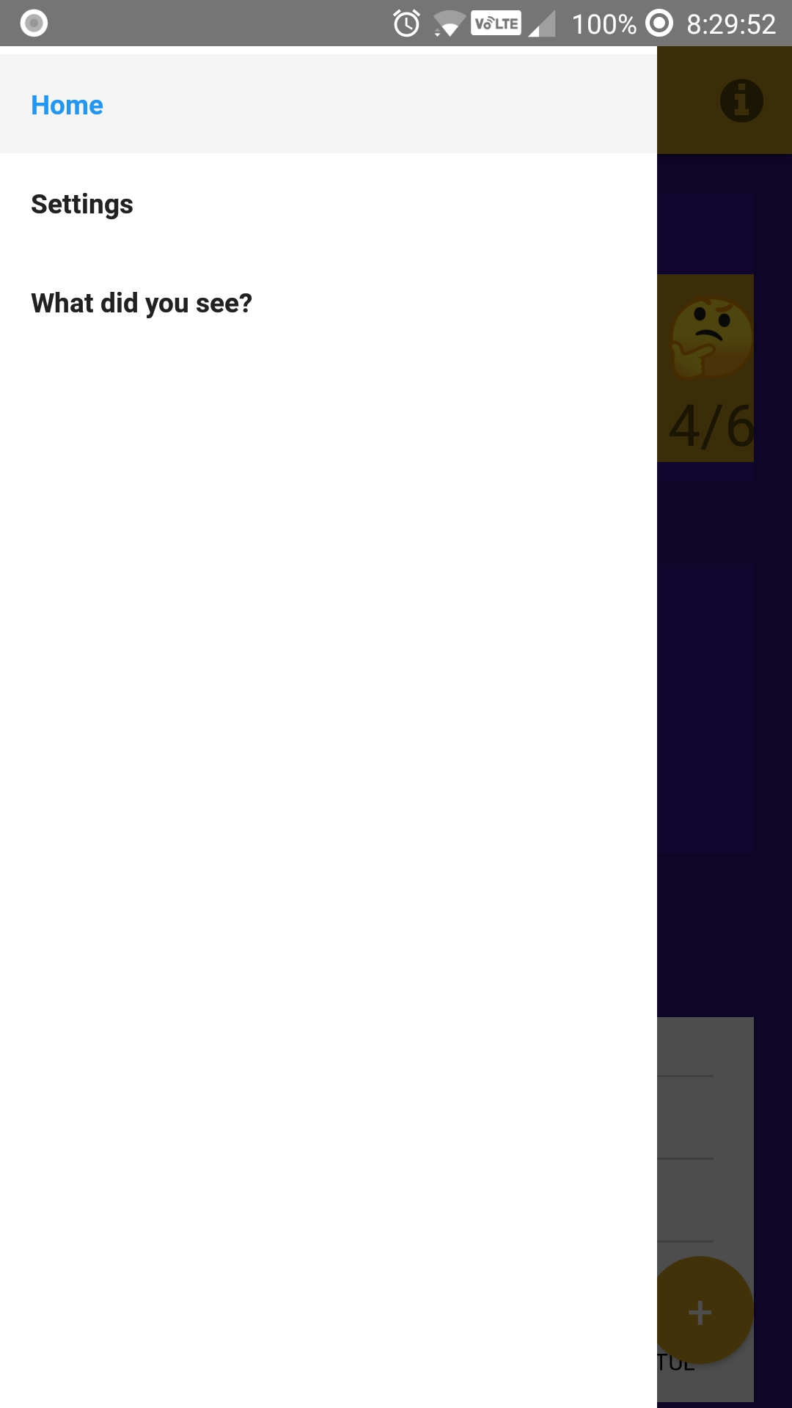
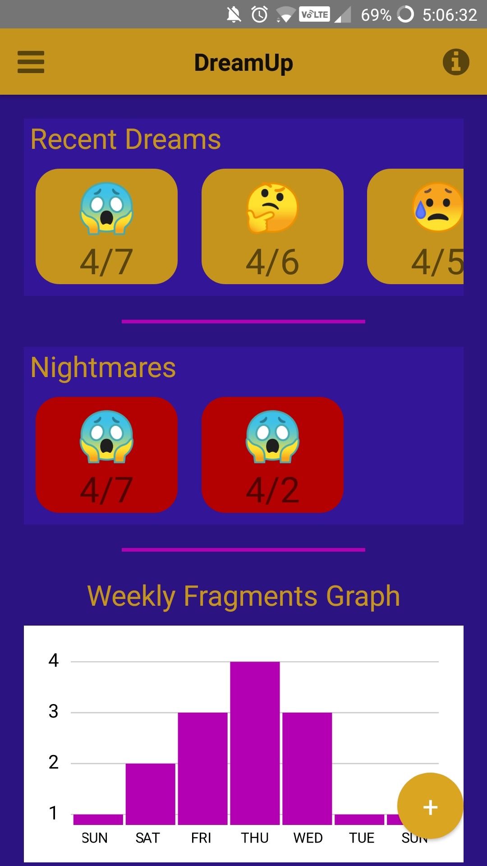
Dream Dashboard Screen
3 Main Components:
Recent Dreams
Nightmares
Weekly Fragments Graph
Each Dream Card links to it’s Dream Screen
FAB starts the process of adding a new dream
Sidebar links to Home, Settings and the ‘What did you see?’ Drawing Screen

Slide 4
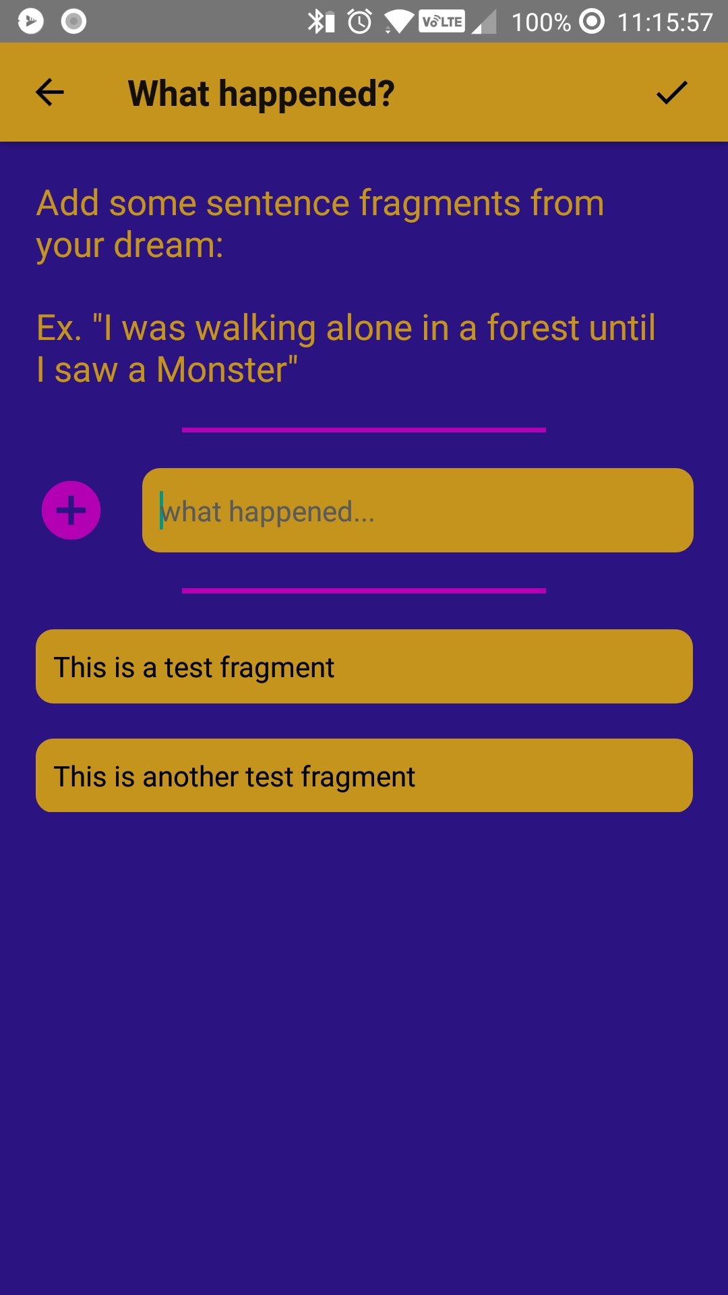
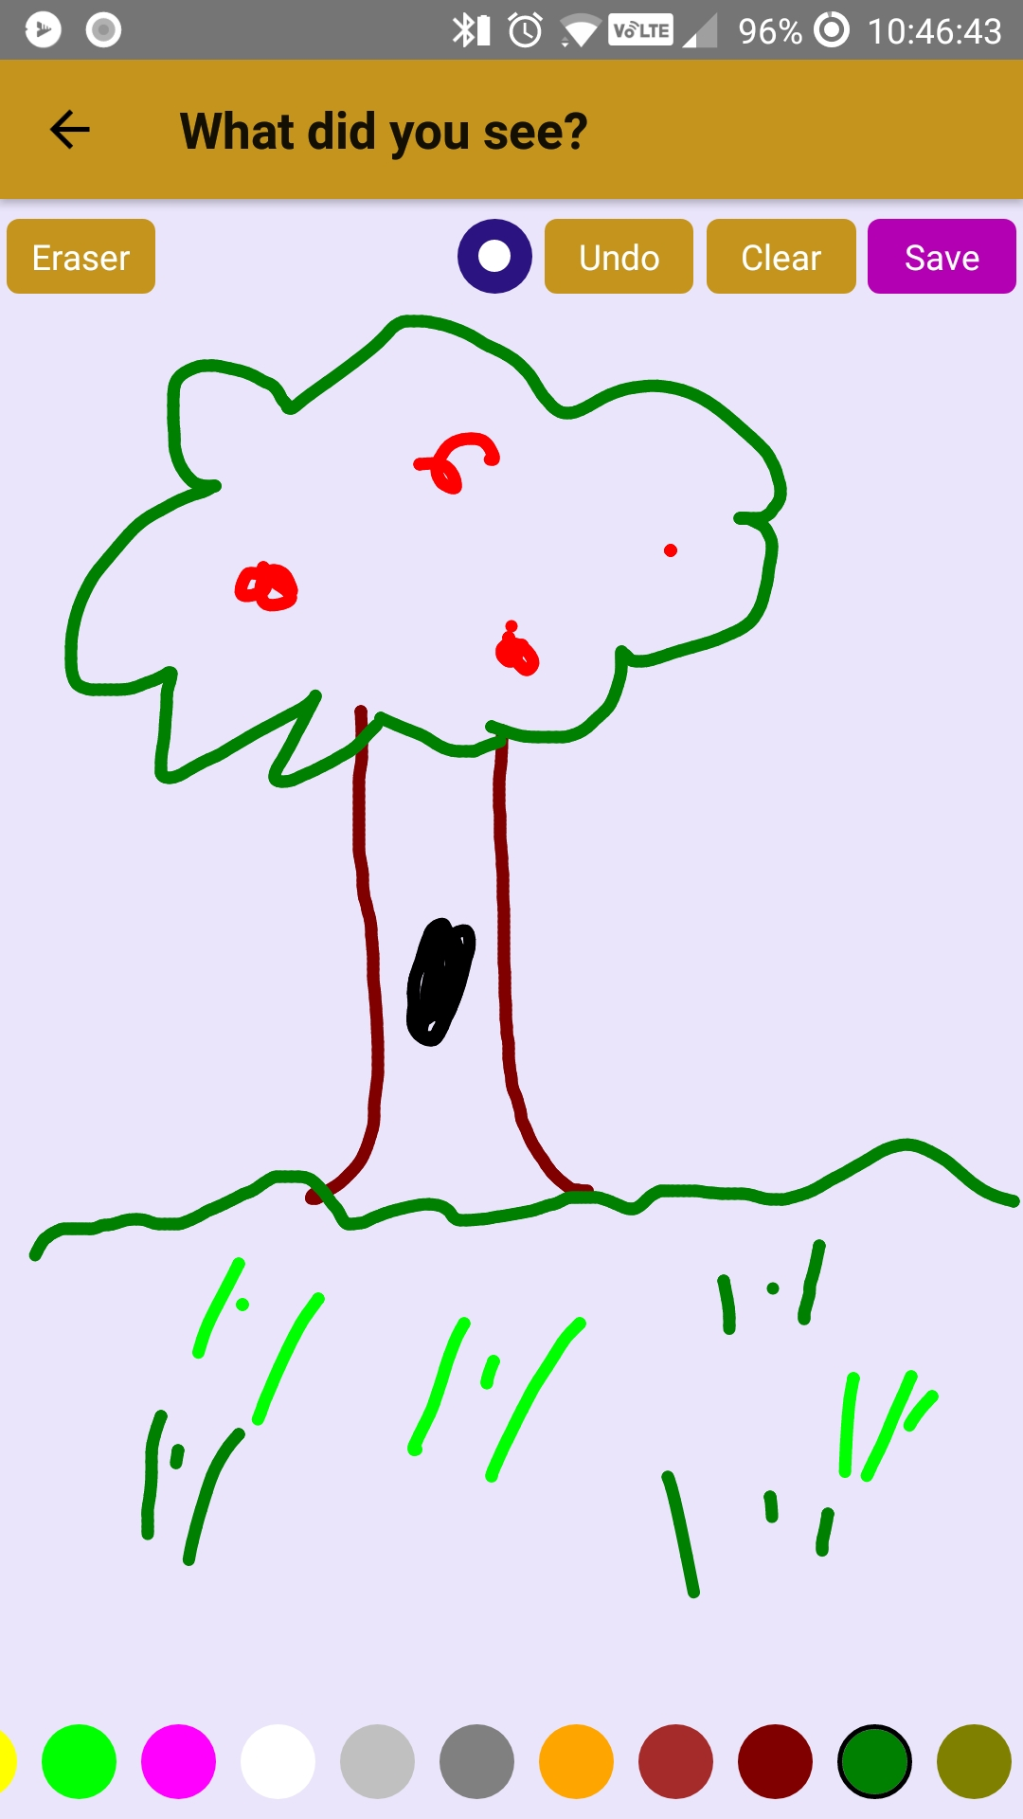
Adding A New Dream
Adding a new dream is a simple 3-step process:
Add the overall reaction, pick an emoji.
Use the touch canvas to draw a vision that’s saved in the pictures folder.
Enter at least one Dream Fragment, describing what happened

Slide 5
Adding A New Dream(Behind the scenes)
The dreams are stored in MongoDB as DreamObjects
Info the user enters is passed as params to the next screen until the Fragment Screen.
After the fragment screen the obj is stored in the DB!
var doc = {
createDate: today,
visionPath: navigation.getParam('visionPath', ''),
fragments: params.getFragments(),
tags: [],
reaction: reaction,
description: '',
id: today.getTime(),
nightmare: reaction == 'afraid' ? true : false,
}
DBManager.getInstance().insert(doc);
{
createDate: dateobj,
visionPath: string,
fragments: [string]
tags: [string]
reaction: string,
description: string,
id: int,
Nightmare: bool,
}

Slide 6
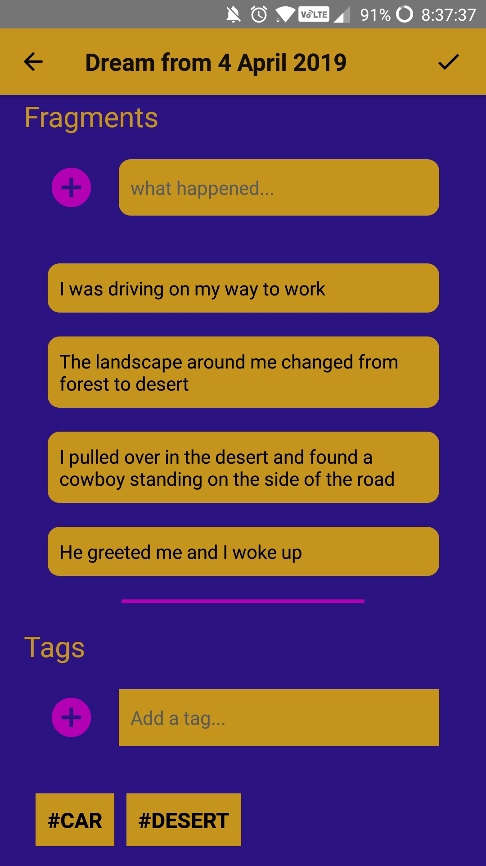
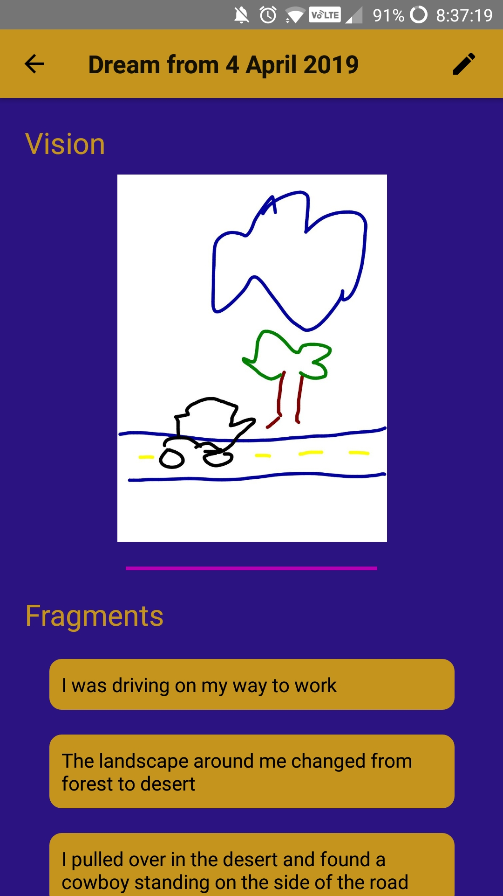
Dream Screen
Contains all information for a dream the user has entered
Two states: ReadOnly and Edit mode
Changes made in edit mode are saved to the DB
Changes made without switching mode back are lost!

Slide 7
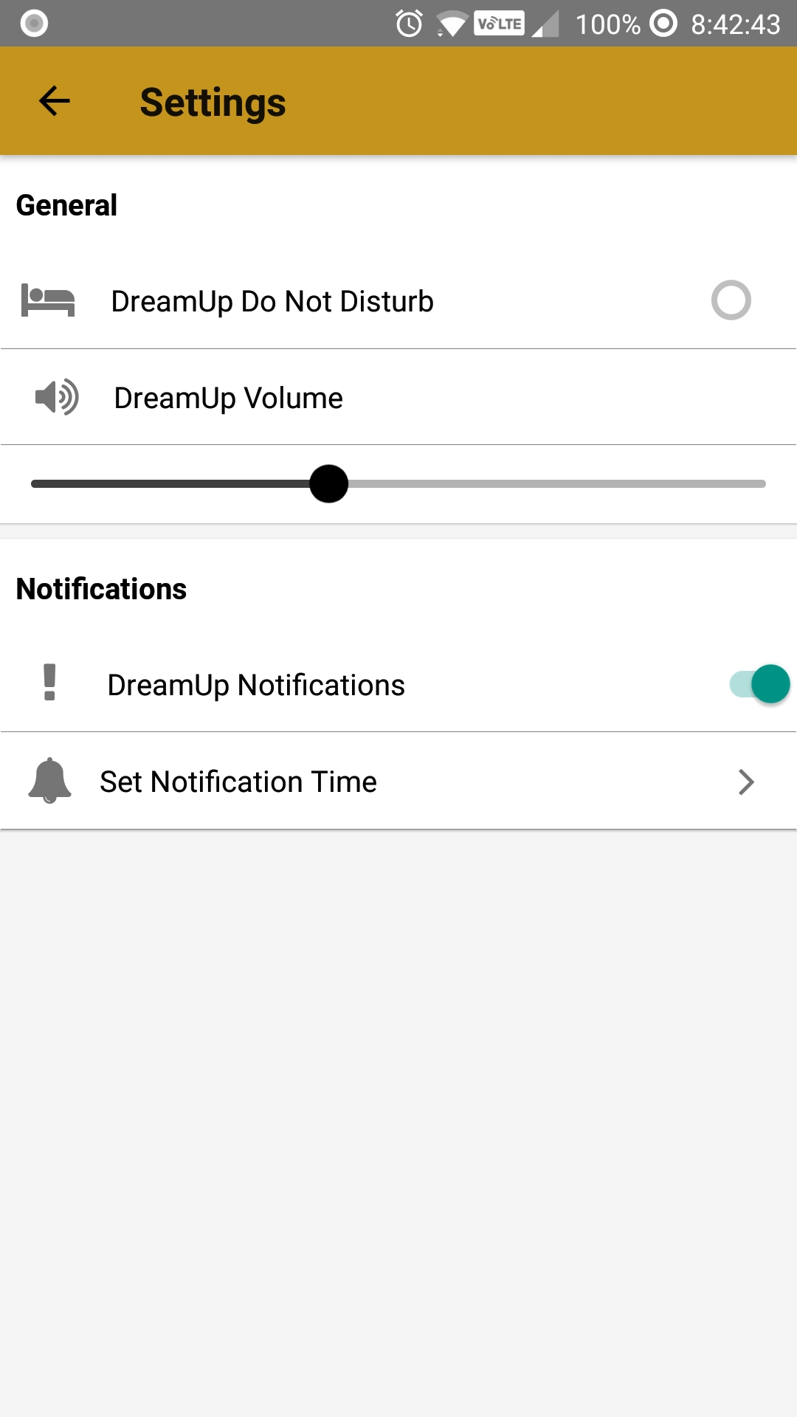
Settings screen
Notifications are managed from the settings screen
Notifications repeat daily at a set time
Do not disturb mode available
When volume is set to zero notifications will also be silent

Slide 8
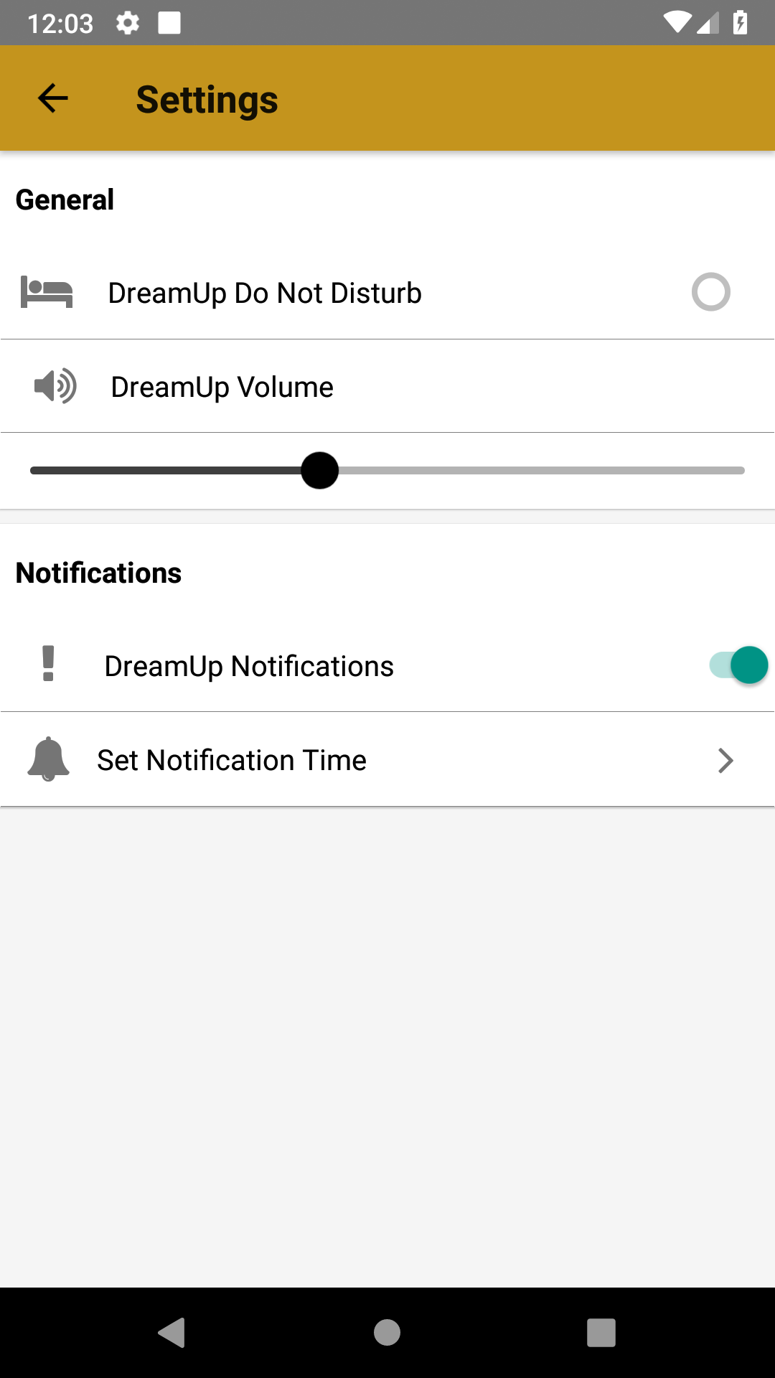
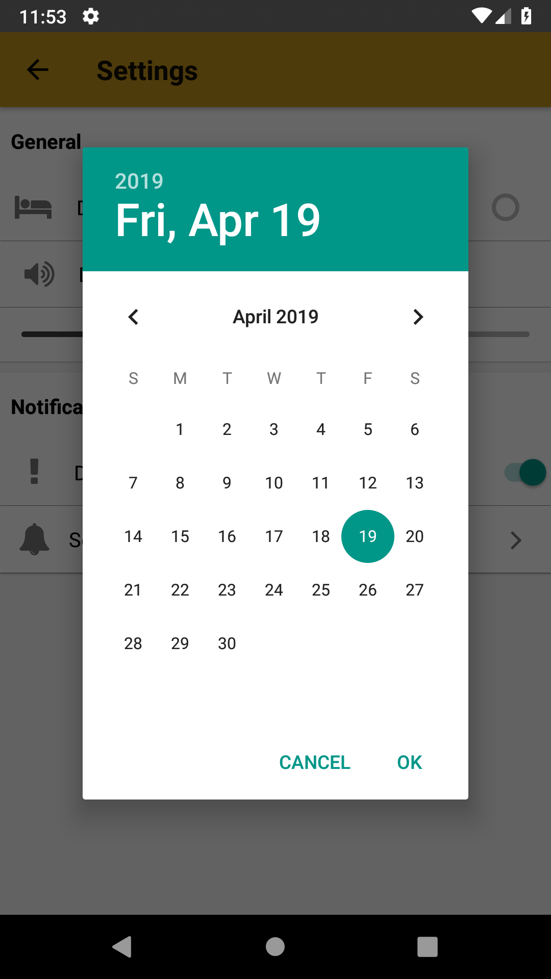
Notifications
Set notifications by turning them on and selecting “Set Notification Time”
Modal will open with a datepicker followed by a time picker
Select day you want notifications to begin
Firebase and react-native-push-notifications utilized to create and send notifications

Slide 9
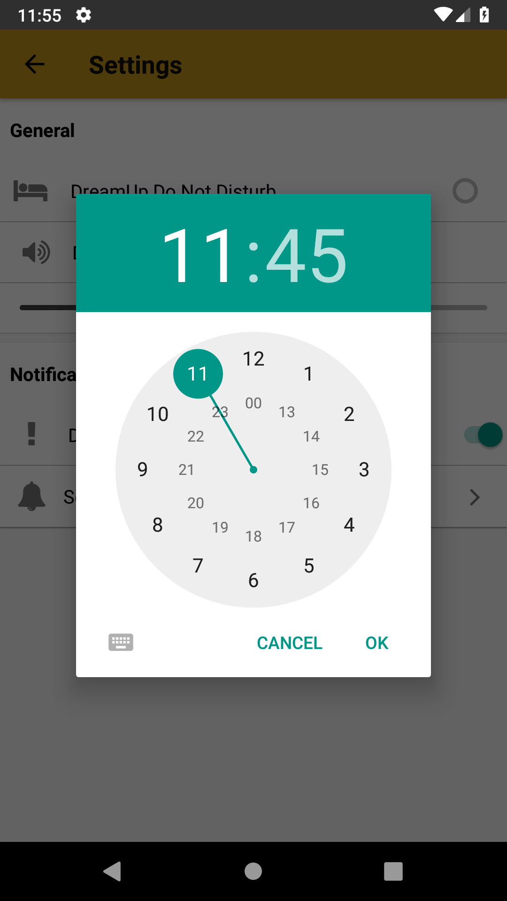
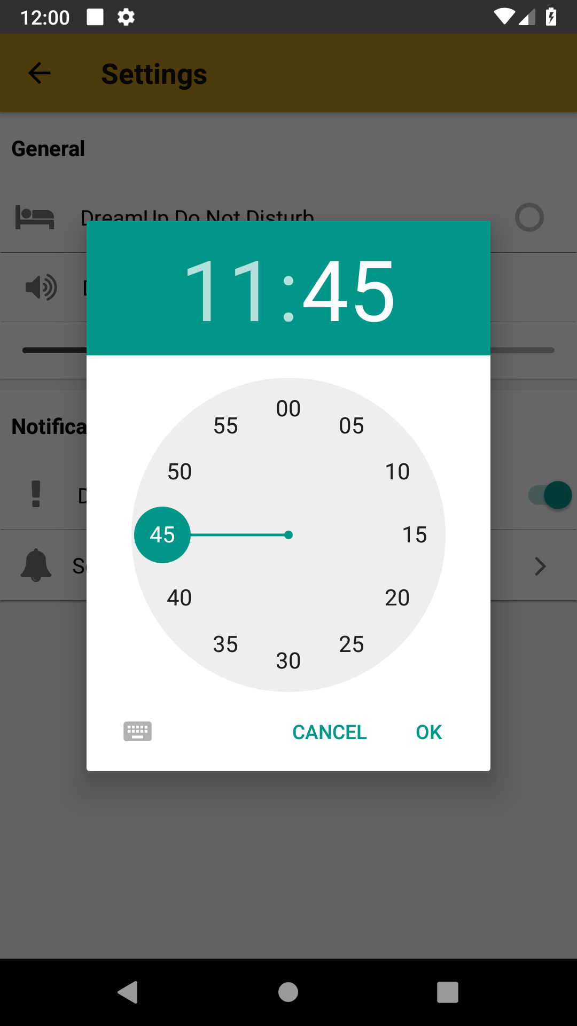
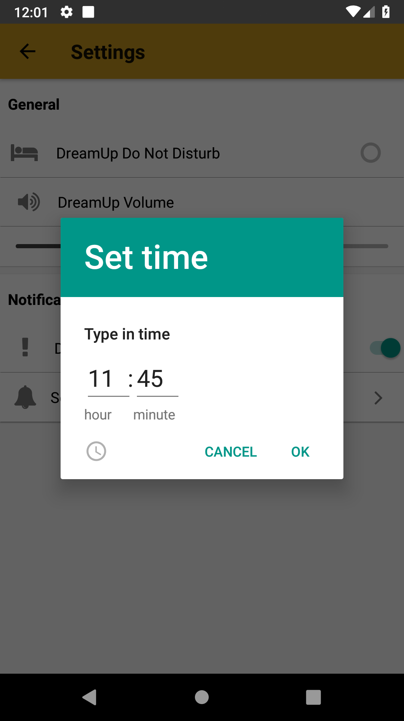
Setting notification Time

Slide 10
Notifications
Notification will appear starting on the date selected and will repeat daily at selected time

Slide 11
Navigation
All navigation done through React Navigation
DreamObject info passed as params until DreamFragment Screen
DreamDashboard
Settings
VisionCanvas
Screen
DreamFragment
Screen
Dream Screen

Slide 12


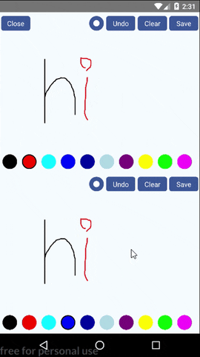
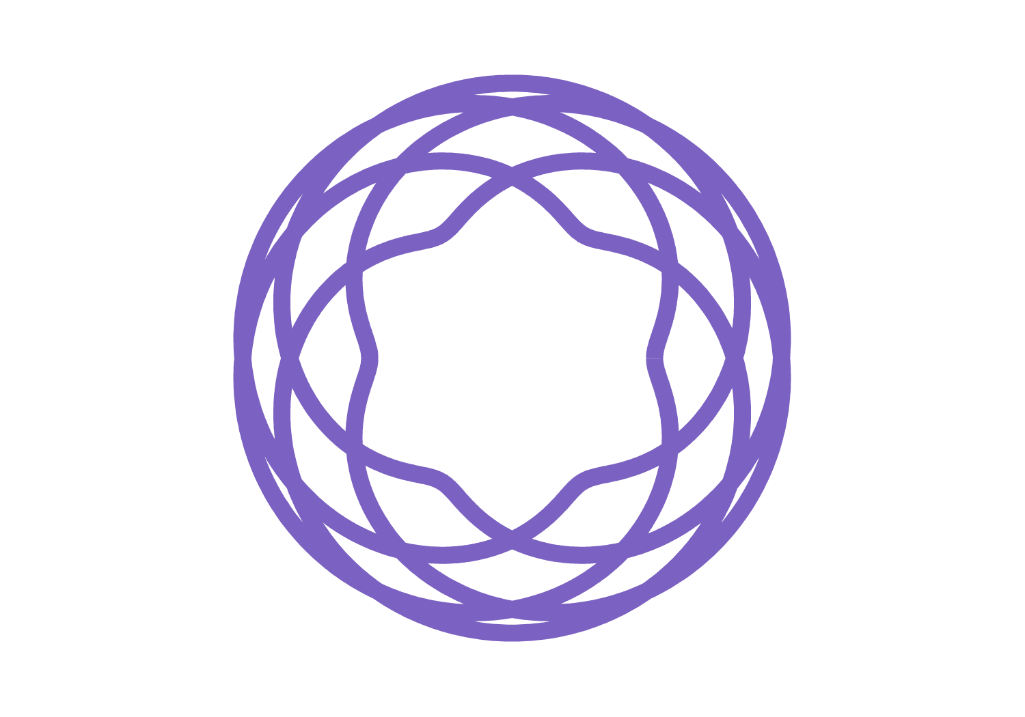
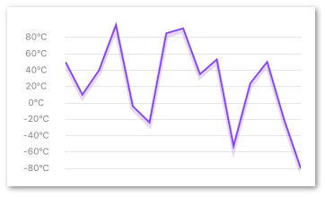
Backend storage/npm packages
MongoDB stores DreamObject info for the user
Firebase manages the push notifications for the reminders
Helpful packages:
react-native-svg-charts
react-native-touch-canvas
react-navigation
react-native-local-mongodb
react-native-firebase
react-native-push-notifications

Slide 13
Demo
https://youtu.be/rA1iG8YYbG8

